Slide 1
Identifying Misinformation in Online News Articles
Presented
Uday Raval
College of Business, Western New England University
Springfield, MA, USA – 01119

Slide 2
Project Objectives
Move from classical ML → Advanced NLP Models
1
Build a Lightweight Transformer baseline
2
Fine‑tune DistilBERT for Fake‑News Classification
3
Add Error Analysis & Interpretability
4
Build an interactive Gradio Web Application
5
Present complete End‑to‑End Pipeline
6

Slide 3
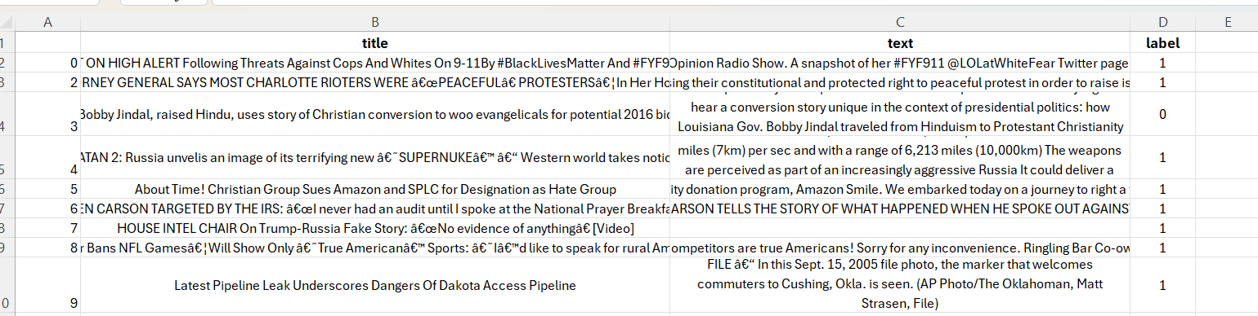
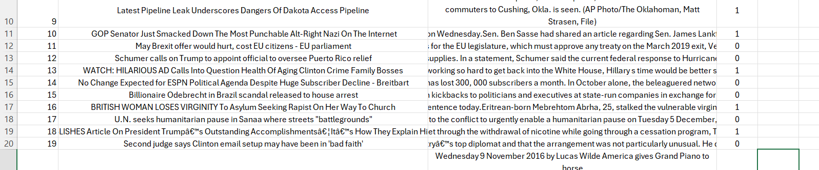
Dataset Overview
Total articles: ~72,000
Labels: 0 = FAKE, 1 = REAL
Contains short news, long articles, headlines
Balanced classes
Sources: multiple online publishers

Slide 4

DATA PREPROCESSING
Removed missing or invalid entries
Converted labels to (0=FAKE, 1=REAL)
Cleaned text:
  Lowercasing
  Remove URLs & HTML
  Remove symbols
  Collapse spaces
Removed duplicates
Added text length distribution

Slide 5
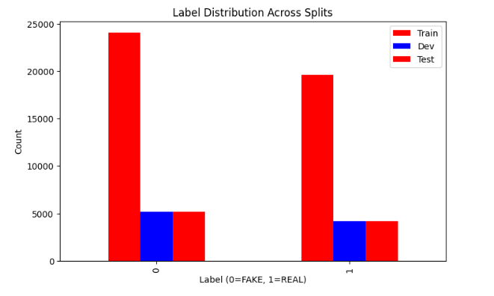
Data Splits
Train: 70%
Dev: 15%
Test: 15%
Stratified split to maintain label balance

Slide 6
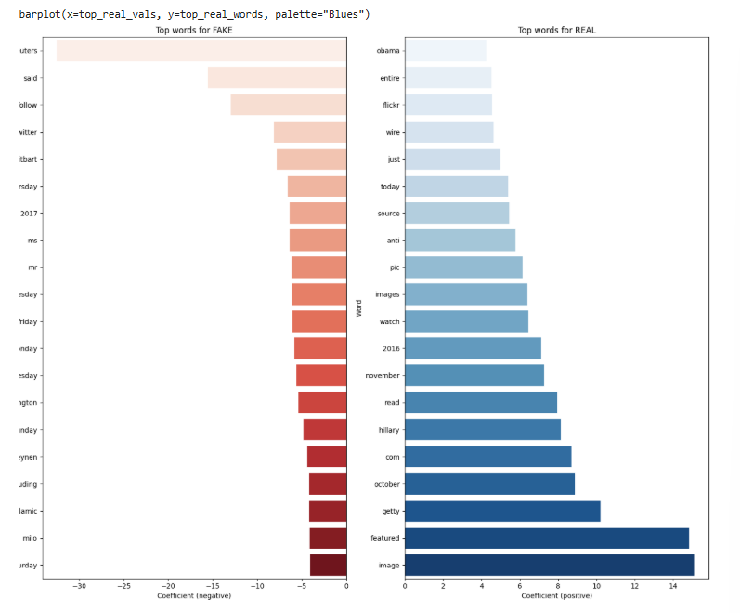
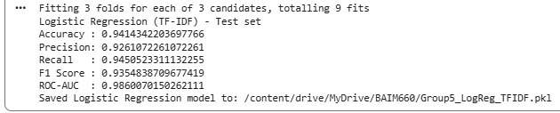
Baseline 1: Logistic Regression + TF‑IDF
Simple but strong baseline
TF‑IDF → Logistic Regression
Grid Search to tune C parameter
Good interpretability

Slide 7
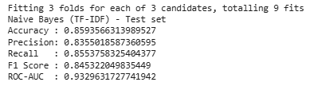
Baseline 2: Naive Bayes + TF‑IDF
Very fast model
Works well with bag‑of‑words
Tuned smoothing parameter α
Lower accuracy than LR

Slide 8
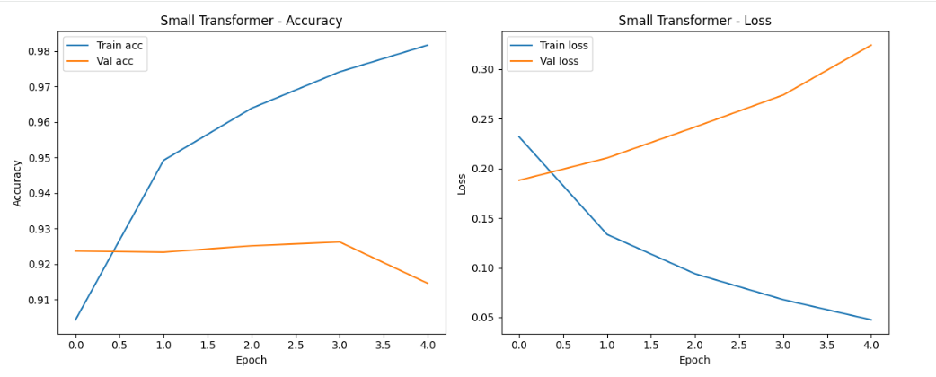
Lightweight Transformer (Keras)
Custom Keras model
Uses:
  TextVectorization
  Embedding
  Multi-head Attention
  LayerNorm + Residuals
Acts as a middle ground between TF‑IDF and DistilBERT
Trained for 5 epochs

Slide 9
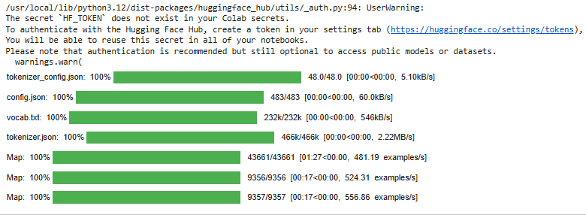
Preparing Data for DistilBERT
Converted to HuggingFace Datasets
Tokenized text → input_ids + attention_masks
Used max_length=128
Created TF datasets with DataCollatorWithPadding
Mixed-precision + XLA for faster training

Slide 10
Fine‑tuning DistilBERT
Model: distilbert-base-uncased
Epochs: 4
Optimizer: AdamW
Warmup steps
Pretrained weights → Fake‑News specific tuning

Slide 11
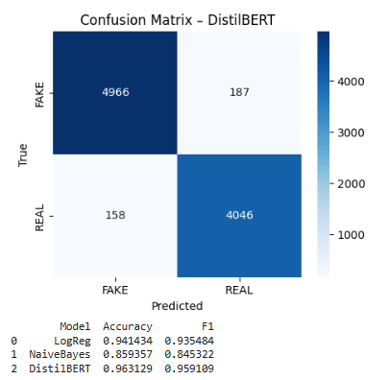
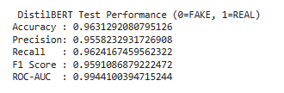
Final Model Evaluation (DistilBERT)
Highest performance among all models
Metrics (Accuracy, Precision, Recall, F1)
ROC‑AUC score
Classification report summary

Slide 12
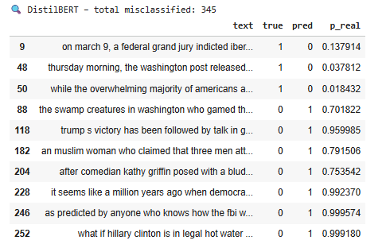
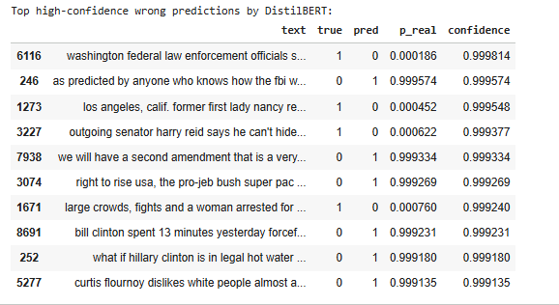
Error Analysis
LR errors:
short text
unusual phrasing
lacking context
BERT errors:
satire-like articles
emotional language
ambiguous real news
High-confidence wrong predictions examined

Slide 13
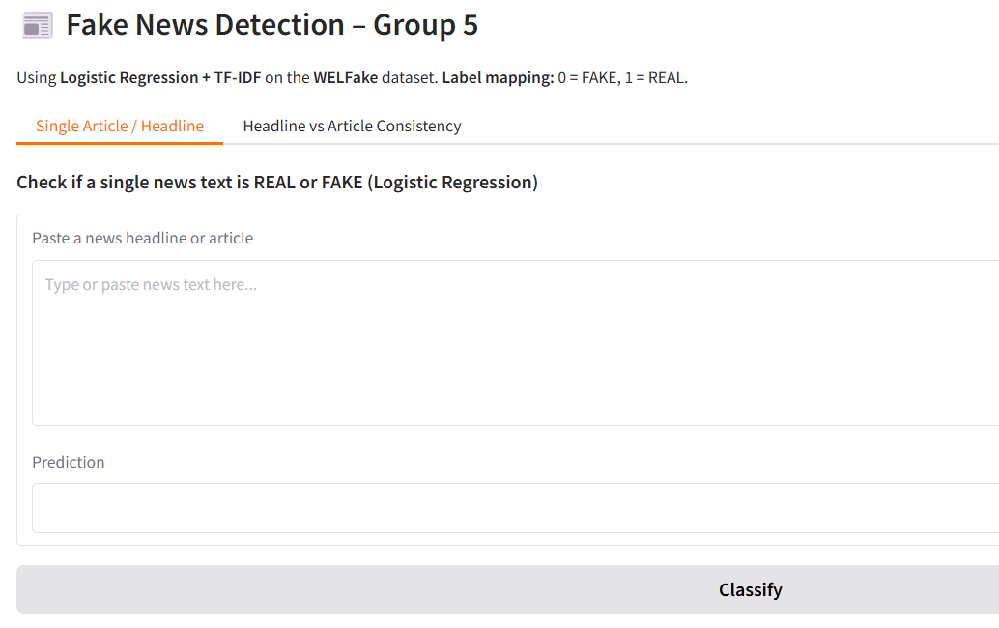
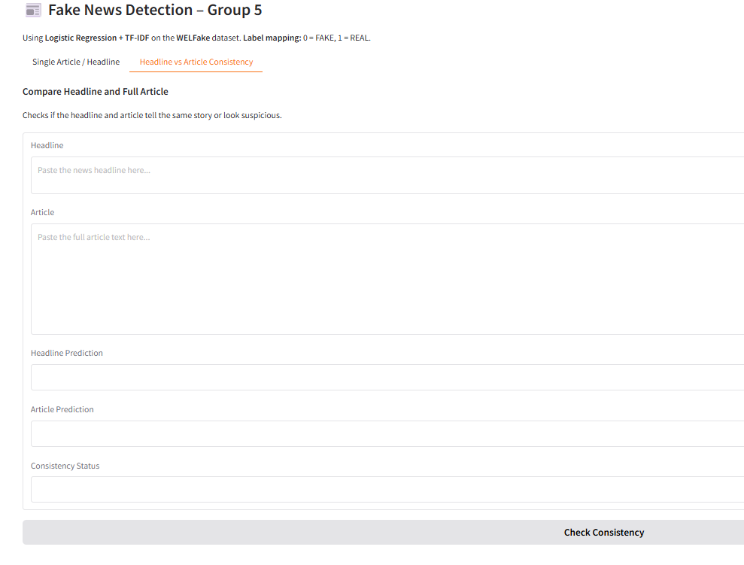
Building the Web Application (Gradio Interface)
Built an interactive web application using Gradio
Provides real‑time Fake News Detection
Model used in web app → TF‑IDF + Logistic Regression (fast & lightweight)
Two major features:
  Single Article/Headline Classifier
  Headline vs Article Consistency Checker
Designed for non‑technical users to easily check suspicious news

Slide 14
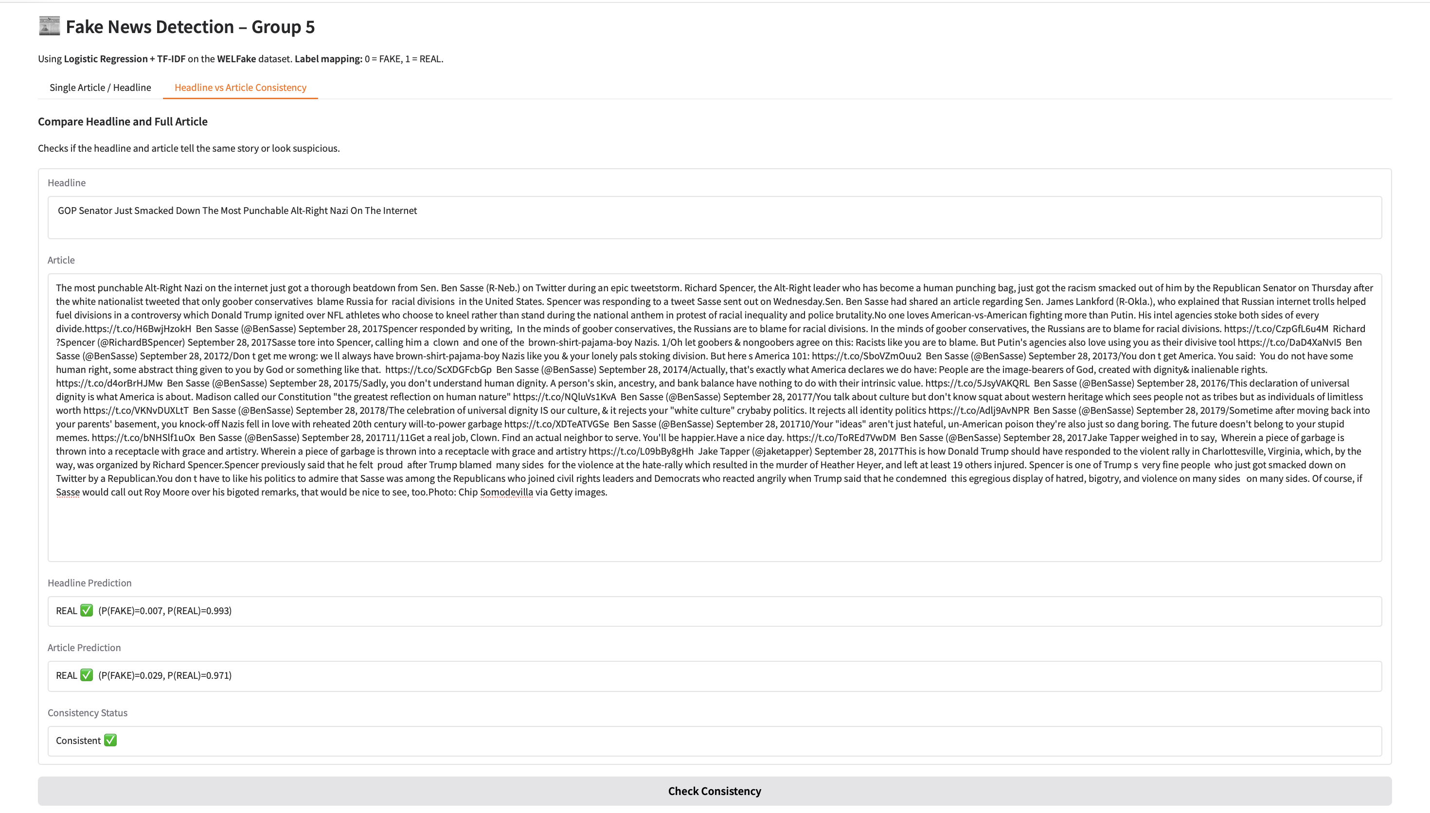
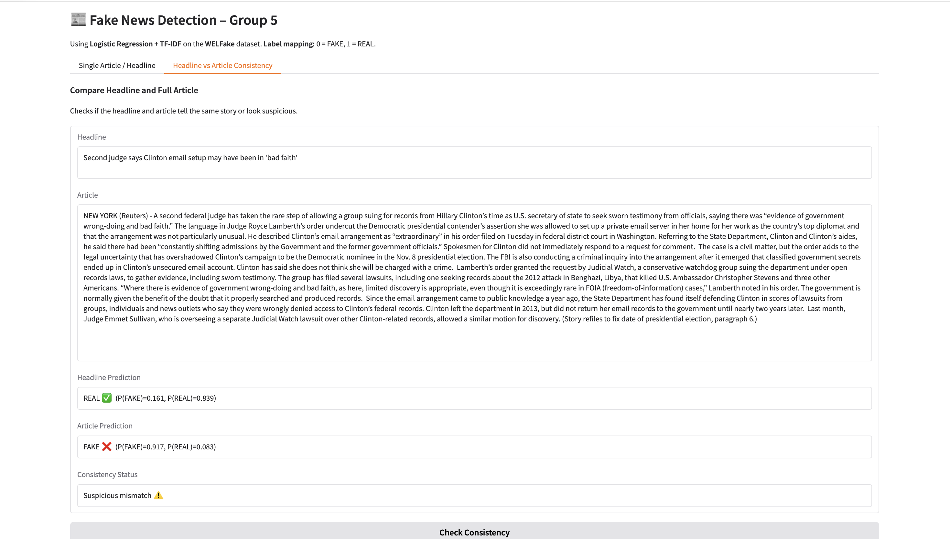
Web App Demo – How It Works
Live demonstration of our Fake News Detector
Real‑time classification with confidence scores
Input → Text article, headline, or full story
Output →
  “REAL ✅” or “FAKE ❌”
  Probability scores for both classes
Consistency Checker flags mismatches
Runs instantly because the LR model is lightweight
Can be extended with BERT in the future

Slide 15
Conclusion
Built a complete end‑to‑end Fake News Detection Pipeline
Cleaned and preprocessed the WELFake dataset
Implemented multiple models:
  Logistic Regression (TF‑IDF)
  Naive Bayes
  Lightweight Keras Transformer
  Fine‑tuned DistilBERT (best performer)
Performed error analysis to understand failure cases
Visualized model behavior through
  Feature importance
  Word clouds
  Confusion matrices
  PR curves
Developed a Gradio web app with two interactive tools
Achieved strong results with high accuracy and F1‑score

Slide 16
Future Enhancements
Replace Logistic Regression in the web app with DistilBERT for higher accuracy
Add Explainable AI (XAI) methods
  SHAP values
  Token-level attribution
Build a multilingual version to support global news
Integrate external knowledge bases
  Wikipedia fact‑checking
  Entity verification
Add stance detection (author supports or opposes topic)
Deploy on cloud (HuggingFace Spaces / AWS / GCP)
Extend the system to detect:
  Misleading headlines
  Clickbait
  Partial misinformation
Create a mobile-friendly UI for public use

Slide 17
Question & Discussion
Thank You & Open Floor for Questions
Presented by
Uday Raval
College of Business, Western New England University
Springfield, MA, USA – 01119

